Slide 1
MICROSOFT STOCK PRICE FORECASTING
GROUP 10
Sojwal Shetye
Tarang Haria
Shivam Naik
Roshan Singh
Sagar Vasaikar

Slide 2
AGENDA
Introduction
Problem Statement and Objective
Data Analysis
-Data Overview
-Data Preparation
Forecasting Methods
Conclusion

Slide 3
Introduction
Microsoft Corporation is an American multinational technology company with headquarters in Redmond, Washington.
It develops, manufactures, licenses, supports and sells computer software, consumer electronics
It was founded on April 4, 1975; 44 years ago in Albuquerque, New Mexico, U.S. by Bill Gates and Paul Allen
The current stock price of Microsoft is 125.44 USD
Notes:
Microsoft Corporation is an American multinational technology company with headquarters in Redmond, Washington
It develops, manufactures, licenses, supports and sells computer software, consumer electronics, personal computers, and related services. April 4, 1975; 44 years ago in Albuquerque, New Mexico, U.S.

Slide 4
PROBLEM DESCRIPTION AND OBJECTIVE
In this project, we aim to forecast future stock price of Microsoft.
We will use past stock price data of Microsoft to forecast future stock price by applying Time Series Theories .

Slide 5
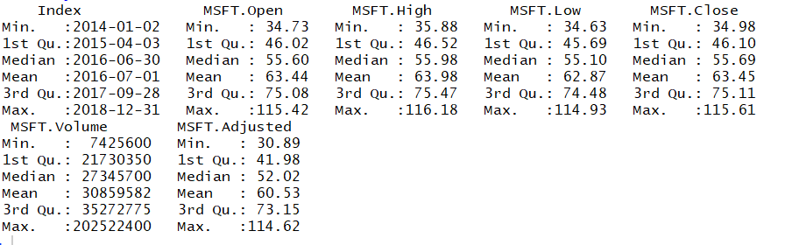
DATA OVERVIEW
Here we have fetched the microsoft stock data of last seven years.
We have splitted the data as training data and Test data consisting of 5 years and 2 years respectively.

Slide 6
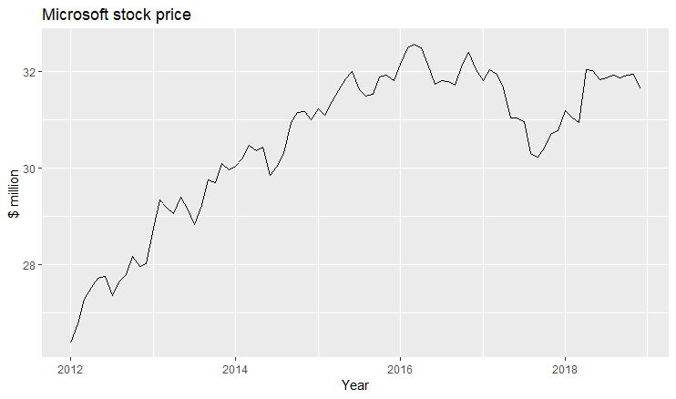
DATA PREPARATION
Extracted the data from Yahoo Finance by Web Crawling
Transformed the data into time series
We have splitted the data as training data and Test data consisting of 5 years and 2 years respectively
Notes:
●Transformed the data into time series
●Transformed the data into time series data
●
●Splitted the data into training and testing set to test the accuracy of the forecasting methods .
ies data
●Extracted the sales data
●Splitted the data into training and testing set to test the accuracy of the forecasting methods .

Slide 7
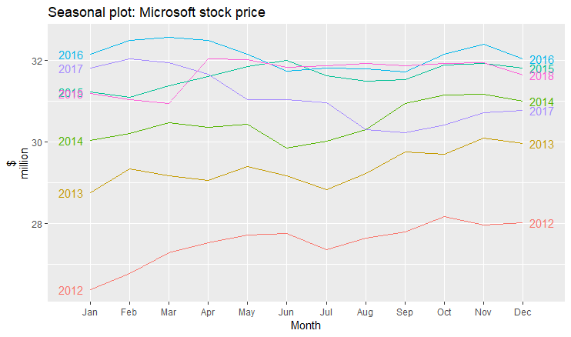
SEASONAL PLOT
We can say that the stock price for the years 2012,2013,2014,2016 and 2017 are increasing in the first quarter which shows strong seasonality

Slide 8
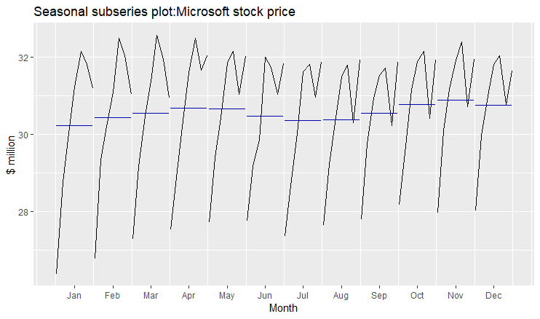
SUBSERIES PLOT
This plot shows us the stock price of Microsoft for all the years month wise.
Blue line indicates the mean of every month.

Slide 9
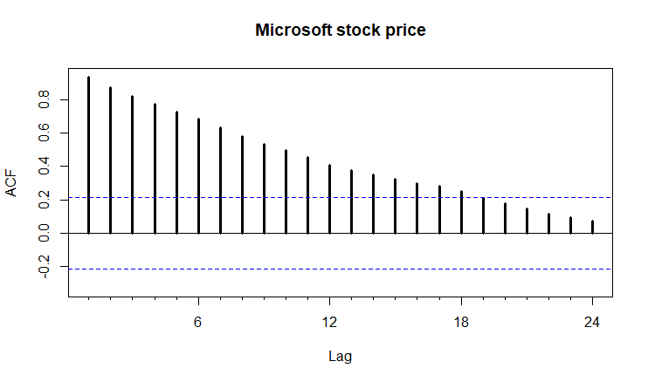
AUTOCORRELATION PLOT
Looking at this plot, we can say that the stock price of Microsoft have strong growing trends throughout the year and also there are some fluctuations every year which indicates a possible seasonal pattern is present

Slide 10
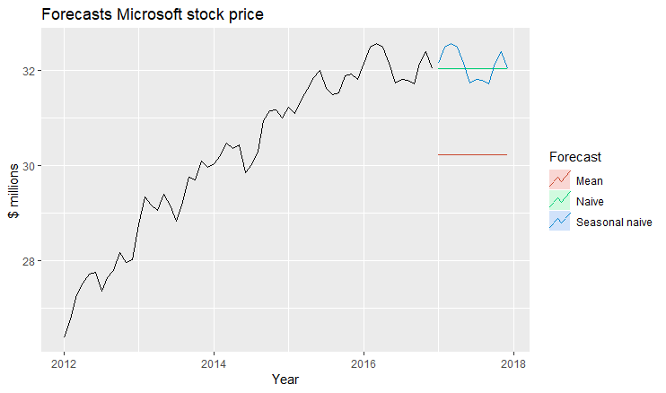
SIMPLE FORECASTING METHODS: MEAN, NAIVE, SEASONAL NAIVE
The mean stock price of Microsoft is around 30.2 million USD.
The stock price of Microsoft using Naive method is the last value that is 32 million USD.
The stock price of Microsoft using Seasonal Naive method follows the stock price of the previous year.

Slide 11
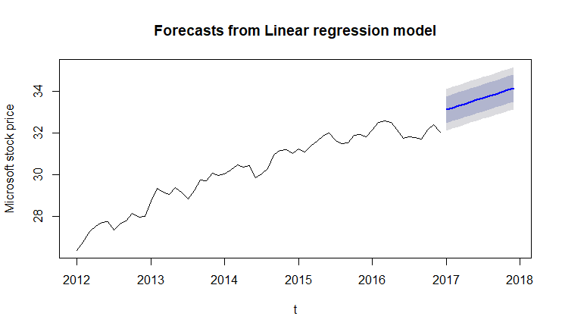
LINEAR TREND MODEL
This plot shows a linear trendline which is the best-fit line
It shows an increase in the stock prices at a steady rate.
Notes:
Tslm function for linear regression

Slide 12
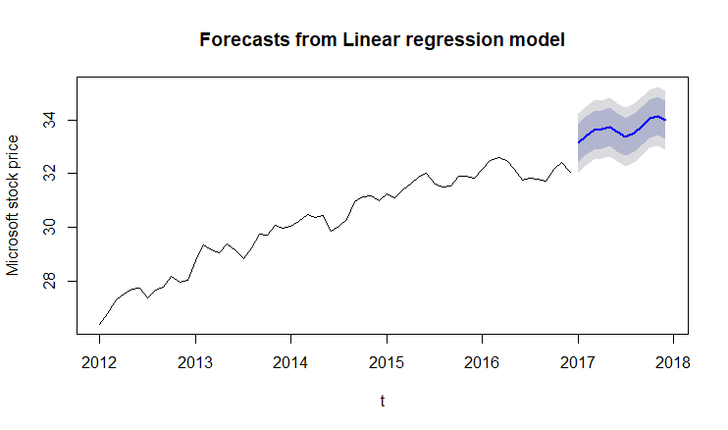
SEASONAL+TREND MODEL
Here the stock price increases following a seasonal trend.

Slide 13
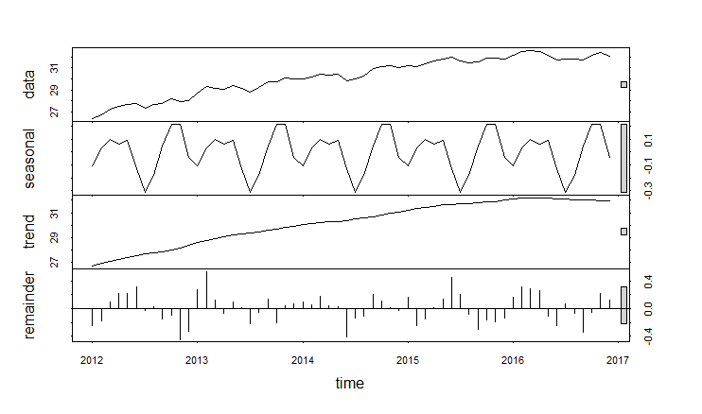
STL DECOMPOSITION
In this plot, we can see the seasonality, trend and error of the Microsoft stock price for all the years.

Slide 14
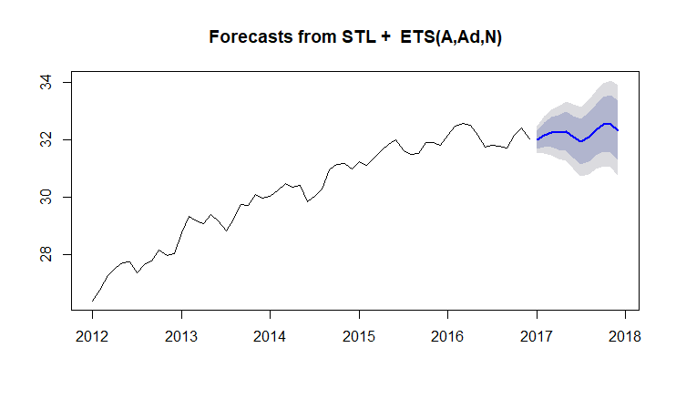
STL & ETS FORECAST
We have forecasted the Microsoft stock price using STL method along with ETS factors.

Slide 15
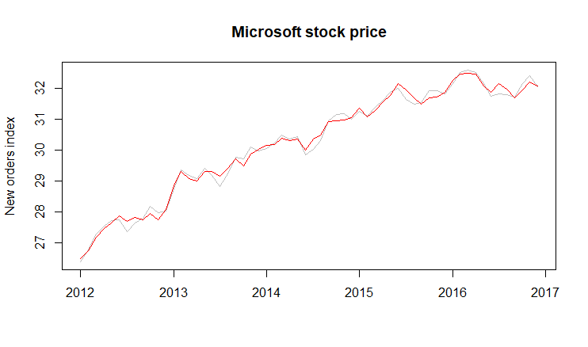
SEASONALLY ADJUSTED PLOT
Red line is the seasonally adjusted data which is obtained by removing the seasonality from the original data.

Slide 16
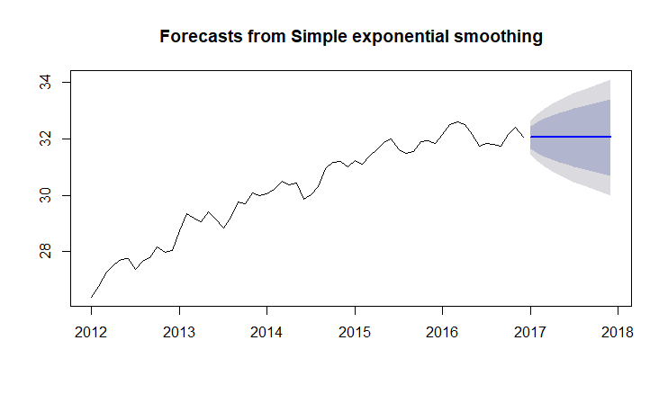
SIMPLE EXPONENTIAL SMOOTHING
In this graph, we give more importance to the last data and less to the previous values.

Slide 17
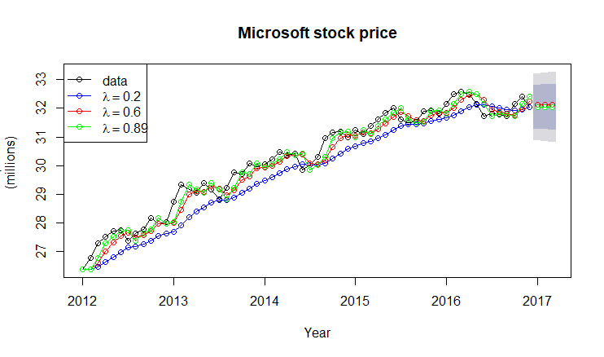
SIMPLE EXPONENTIAL SMOOTHING
This graph is made up using the Lambda function to get a smoother curve.
We have selected the Lambda values as 0.2,0.6 and 0.89.
We achieve a smoother curve with the Lambda value 0.89.

Slide 18
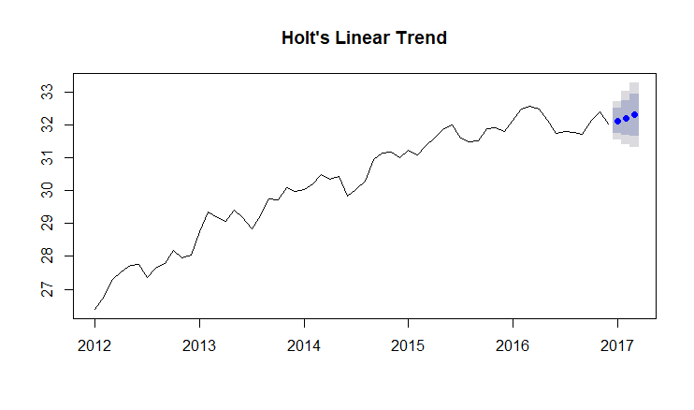
HOLT’S LINEAR TREND

Slide 19
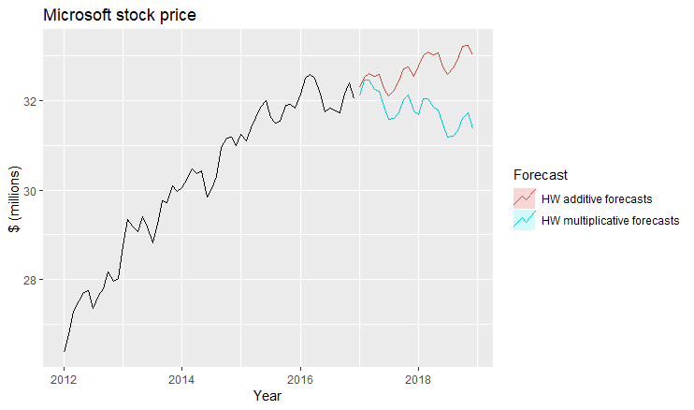
HOLT WINTERS METHOD - ADDITIVE AND MULTIPLICATIVE

Slide 20
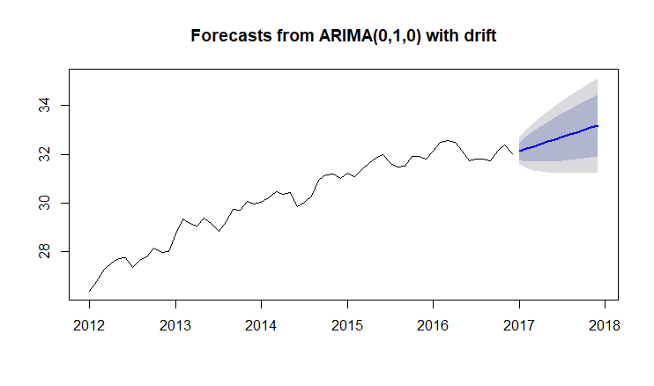
AUTO ARIMA MODEL

Slide 21
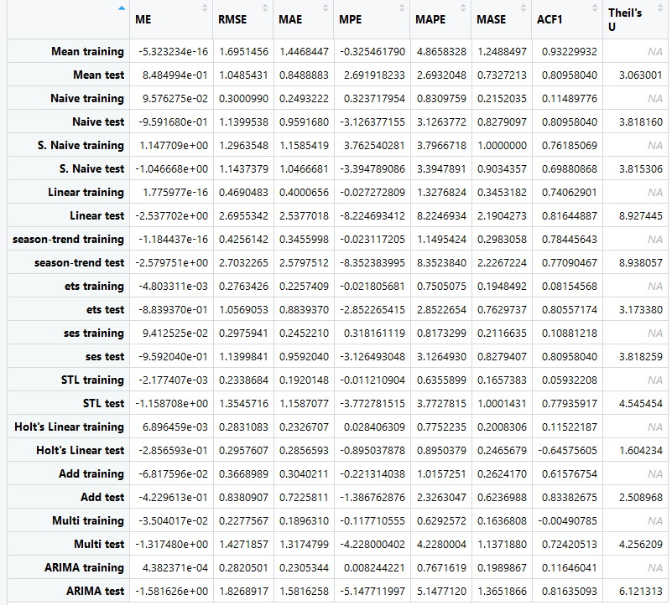
ACCURACY

Slide 22
SUMMARY AND CONCLUSION
From the accuracy table we can see that Holt’s Linear Trend Model, Holt’s Additive Model and Arima Model gives us the best accuracy of 99%.
Mean, Naive, Snaive models also gives good accuracy of around 98%.
We get low accuracy scores for Linear Trend Model and Seasonal Trend Model which is around 96%.
Also, Stock tends to increase in future based on our forecasting

Slide 23
THANK YOU

